Slide 1

COIS 3320H: Fundamentals of Operating Systems
Alaadin Addas
Week 2
Processes & Threads
Introduction to C Programming

Slide 2
Overview
Recap
Processes
The Concept of a Process
Why We Utilize Processes
The Process Control Block
Operations on Processes
Resources
Threads
Basics of C Programming/Loki

Slide 3
Recap
Last week, we reviewed some basic terminology and concepts as they relate to Operating Systems.
What is a kernel?
The kernel of an OS is the minimal set of functions necessary to manage the system resources safely and efficiently.
What is a privileged Instruction?
A privileged instruction performs critical operations that access I/O devices and the CPU's status and control registers.
What is an interrupt?
An interrupt is an event that diverts the current execution of a program to a predefined location in the kernel in order to respond to an event.

Slide 4
The Concept of a Process
Process: A process is an instance of a program being executed by an OS.
Process control block (PCB): A data structure that holds information for a process, including the current instruction address, the execution stack, the set of resources used by the process, and the program being executed.

Slide 5
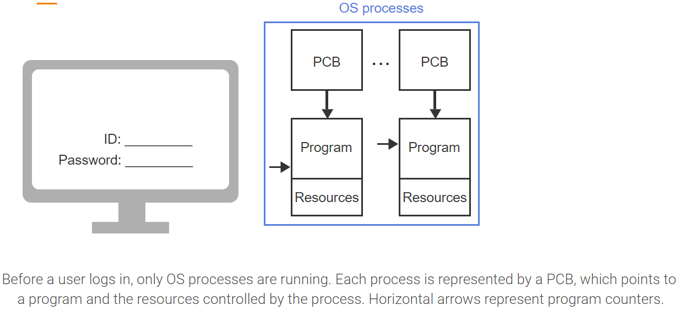
The Concept of a Process – Visualized (1)

Slide 6
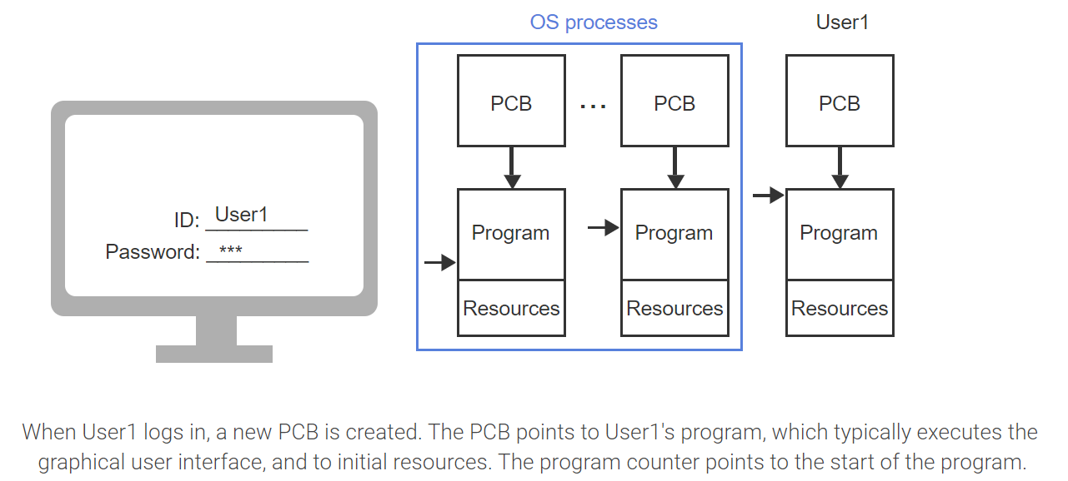
The Concept of a Process – Visualized (2)

Slide 7
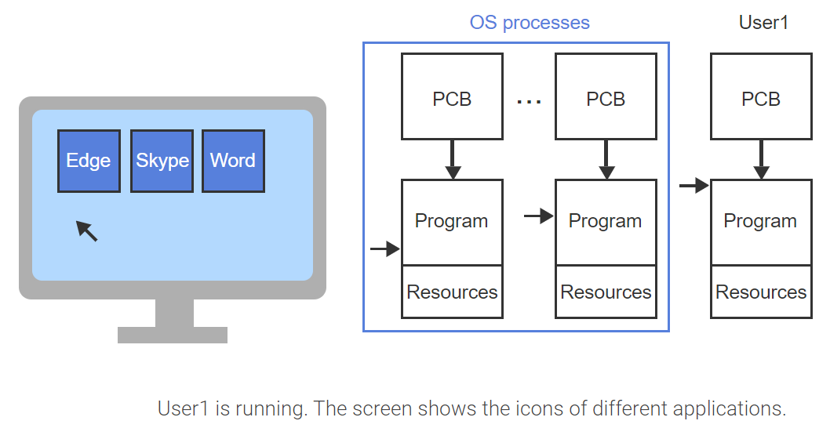
The Concept of a Process – Visualized (3)

Slide 8
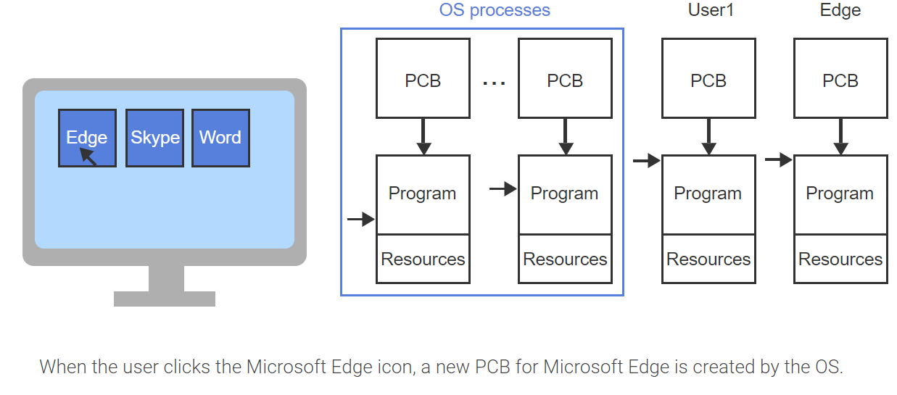
The Concept of a Process – Visualized (4)

Slide 9
Process States
Running State: A process is in the running state (or running) when the process has all necessary resources and the CPU is actively executing the program's instructions.
Ready State: A process is in the ready state (or ready) when the process has all necessary resources to run but the CPU is currently unavailable.
Blocked State: A process is in the blocked state (or blocked) when the process is waiting on a currently unavailable resource.
Moving between states is known as a State Transition.

Slide 10
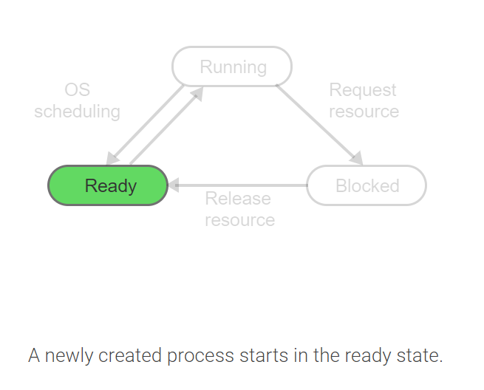
Moving Between States – 1

Slide 11
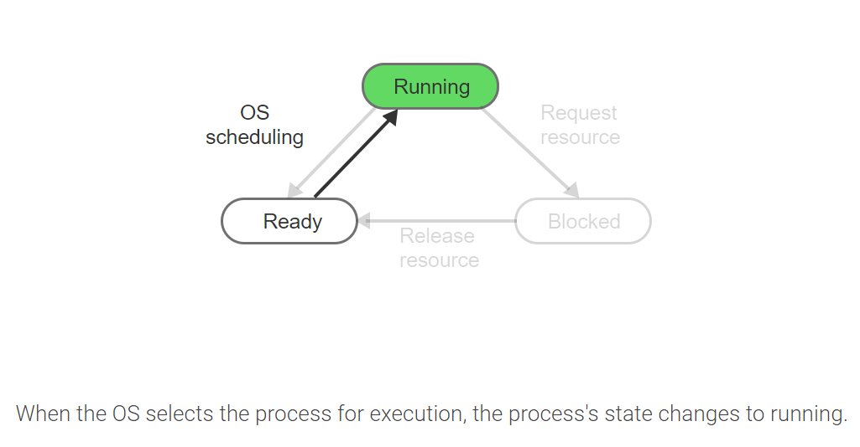
Moving Between States - 2

Slide 12
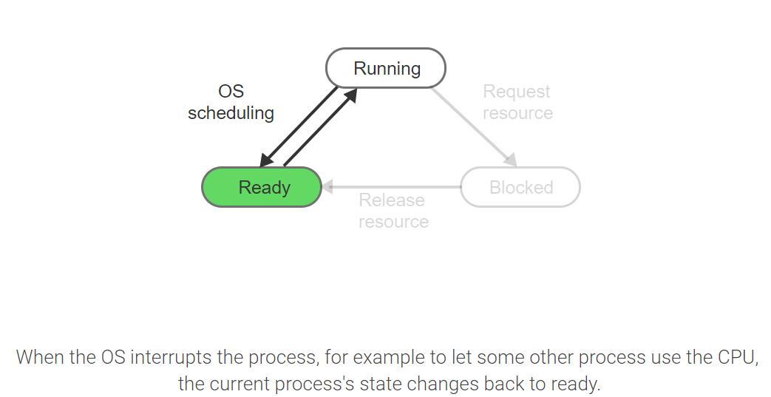
Moving Between States - 3

Slide 13
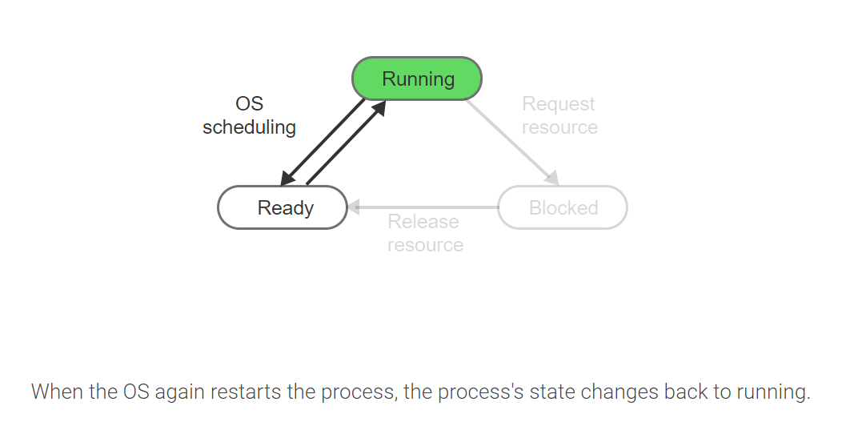
Moving Between States - 4

Slide 14
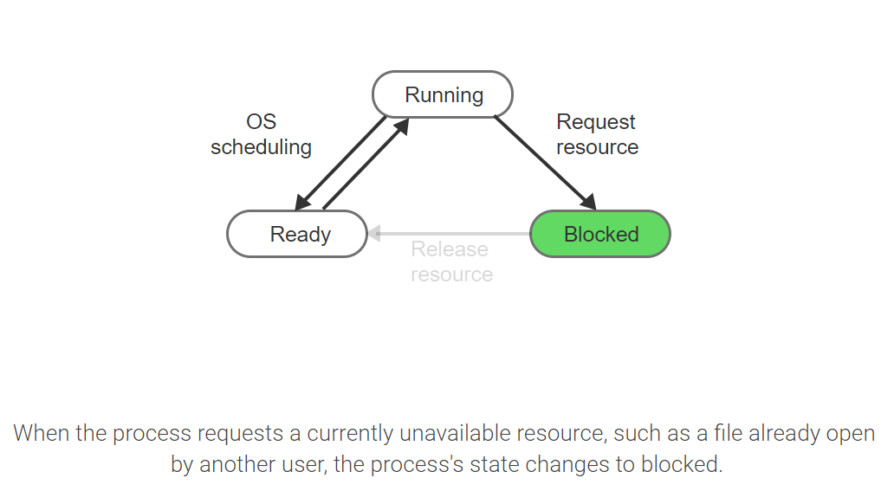
Moving Between States - 5

Slide 15
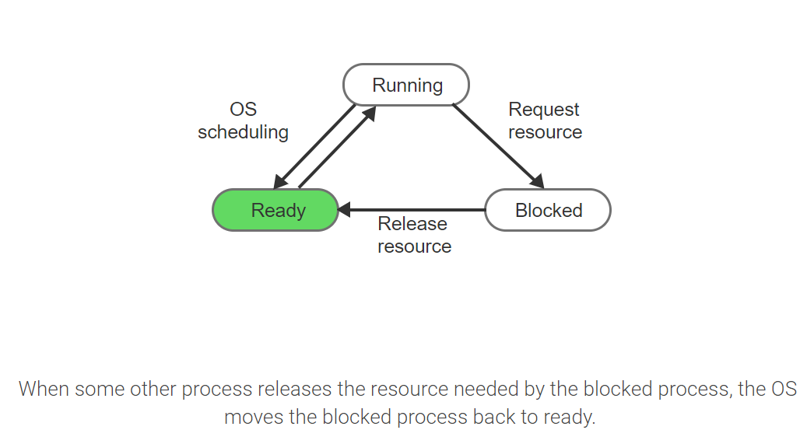
Moving Between States - 6

Slide 16
Additional States
New State: A newly created process is placed into the new state before the process is allowed to compete for the CPU.
Terminated State A process is placed into the terminated state when execution can no longer continue but before the PCB is deleted.
Suspended State A process may be placed into the suspended state even though the CPU and all resources are available.

Slide 17
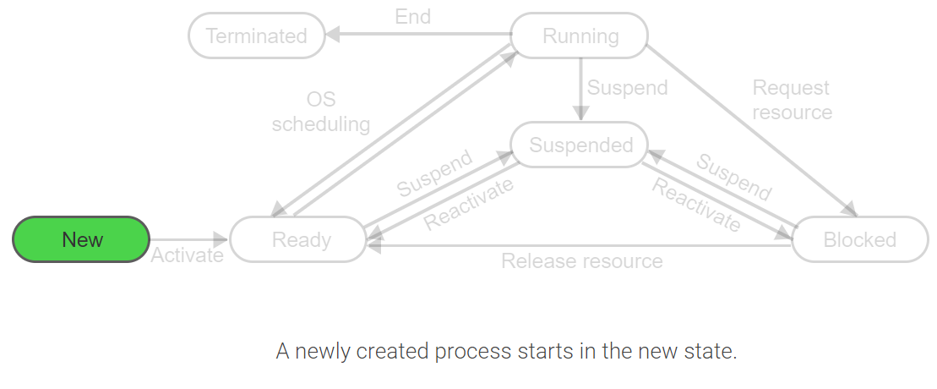
State Transitions - 1

Slide 18
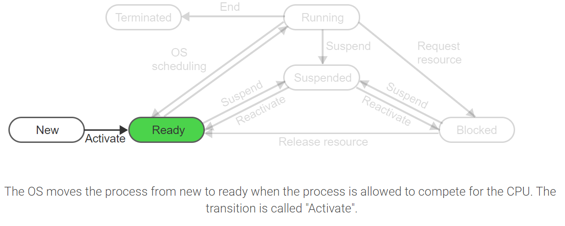
State Transitions - 2

Slide 19
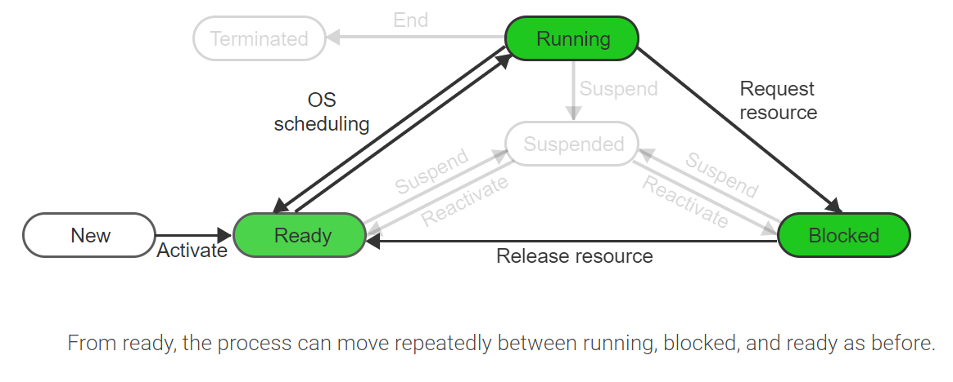
State Transitions - 3

Slide 20
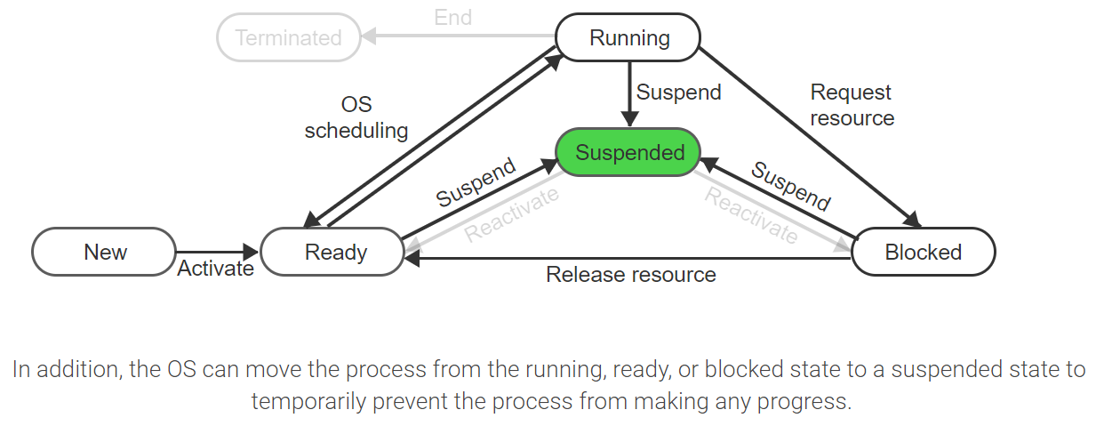
State Transitions - 4

Slide 21
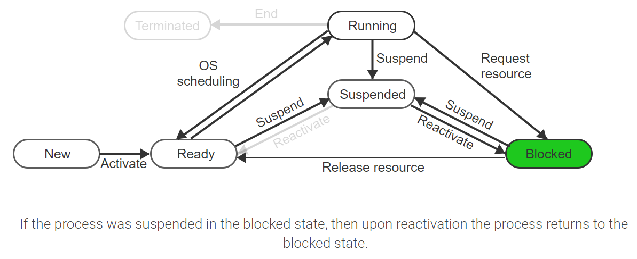
State Transitions - 5

Slide 22
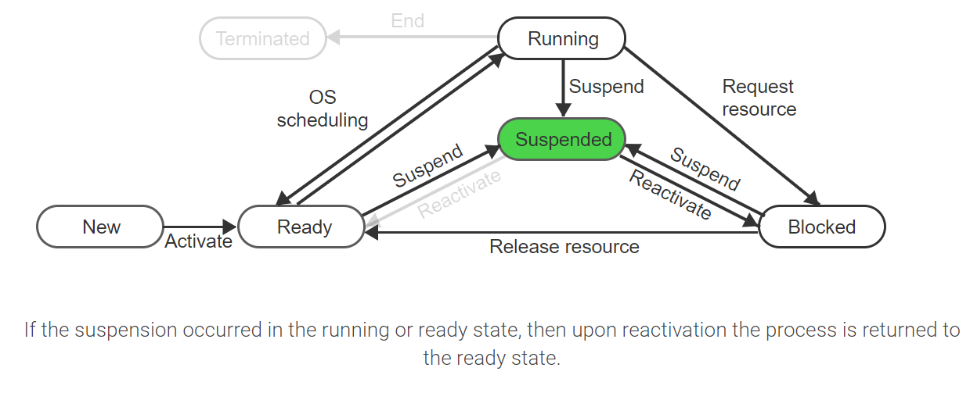
State Transitions - 6

Slide 23
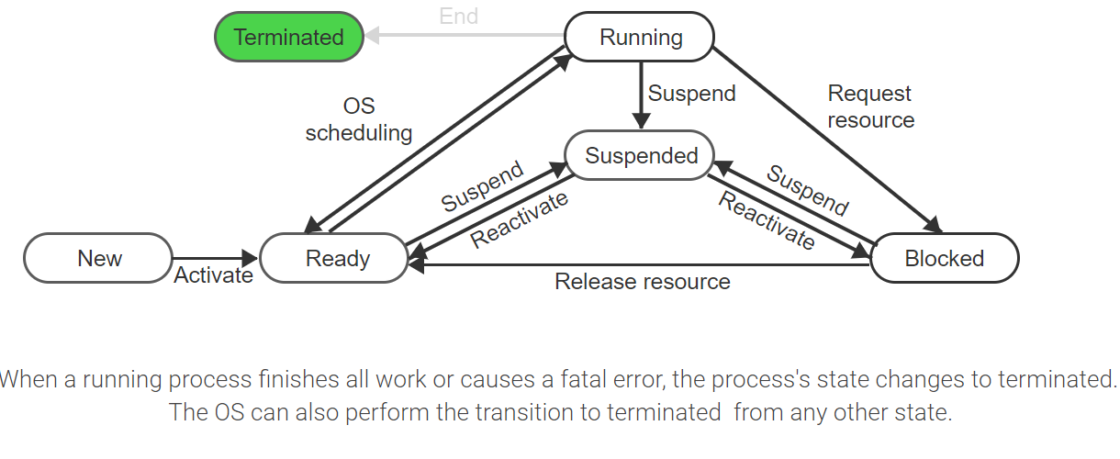
State Transitions - 7

Slide 24
State Transitions – Exercise
Which of the following state transitions are possible?
Blocked → Running
Blocked → Ready
Running → Suspended
Ready → Blocked
Running → Ready
Suspended →Running

Slide 25
State Transitions – Exercise Solution
The possible transitions are:
Blocked -> Ready: A process must be running in order to make a request and potentially get blocked. When the resource on which process p is blocked becomes available, p becomes ready.
Running -> Suspended: A process can be suspended from any of the states: running, ready, blocked.
Running -> Ready: A running process may be interrupted and moved to the ready state in order to let other processes use the CPU

Slide 26
Context Switch & CPU State
A context switch is the transfer of control from one process to another.
In many cases we assume that a context switch takes negligible time so we count it as zero.
However, a context switch takes a measurable amount of time on Linux Operating Systems (µ1.2 - µ2.5).
CPU Sate: The CPU state consists of all intermediate values held in any CPU registers and hardware flags at the time of the interruption.

Slide 27
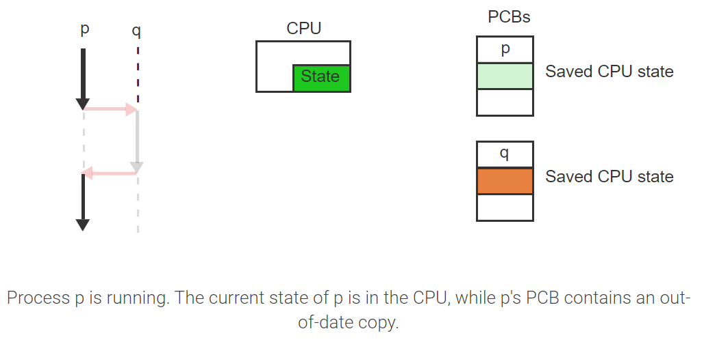
Context Switching – Visualized – 1

Slide 28
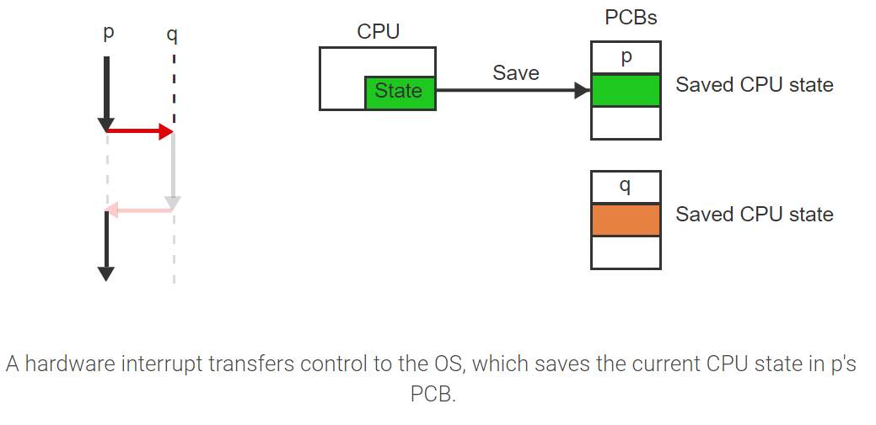
Context Switching – Visualized – 2

Slide 29
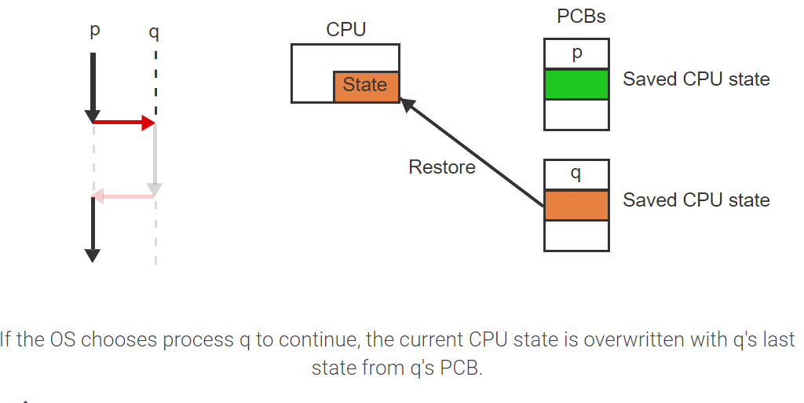
Context Switching – Visualized – 3

Slide 30
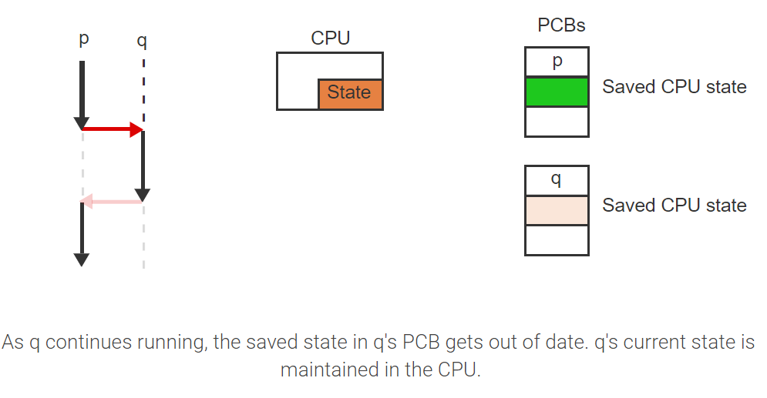
Context Switching – Visualized – 4

Slide 31
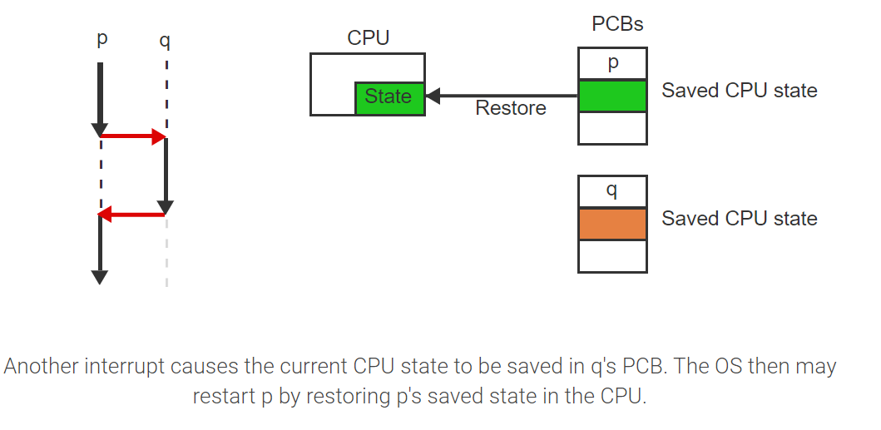
Context Switching – Visualized – 5

Slide 32
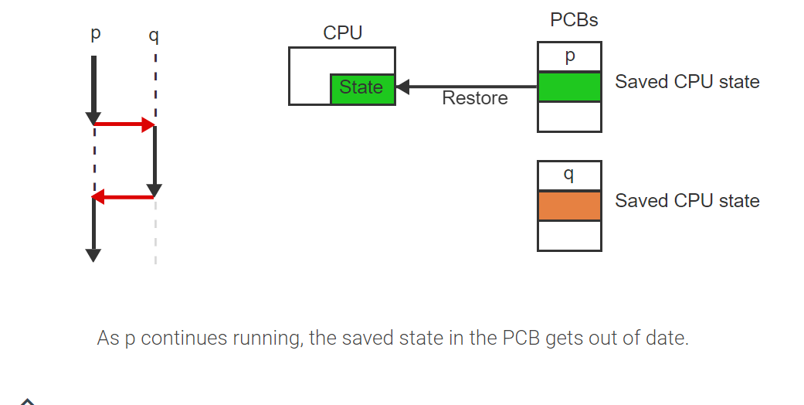
Context Switching – Visualized – 6

Slide 33
Why Processes
A physical CPU is a real hardware instance of a CPU.
Time Sharing: Multiple processes may run on one physical CPU using a technique known as time sharing.
Virtual CPU: A CPU that the process assumes is available only to itself.
Multiple processes can run on different hardware configurations but in all cases each process can assume having the same private physical CPU.
Why might this be necessary?

Slide 34
The Process Control Block (PCB)
Contents of a PCB:
The PCB is the instantiation of a process. Upon creation, the OS assigns every process a unique identifier. This identifier, p, could be a pointer to the PCB structure or an index into an array of PCBs.
The specific implementation and the contents of a PCB vary between different OSs but the following is a generic structure representative of most modern OSs.

Slide 35
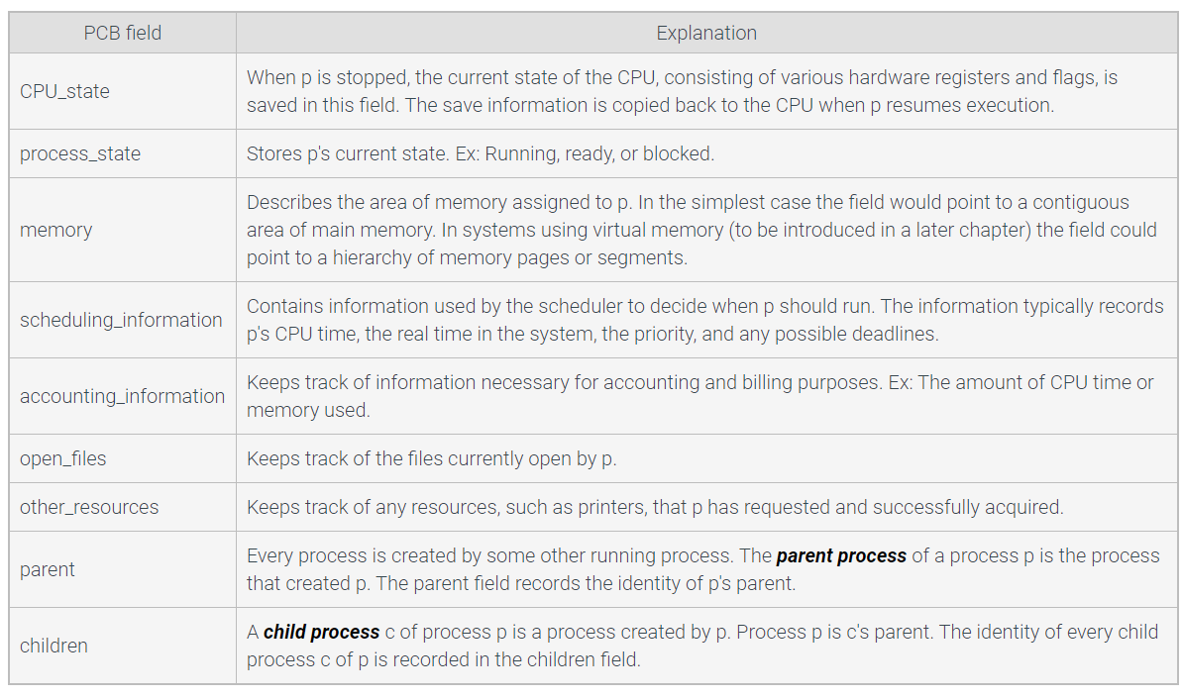
Generic - PCB

Slide 36
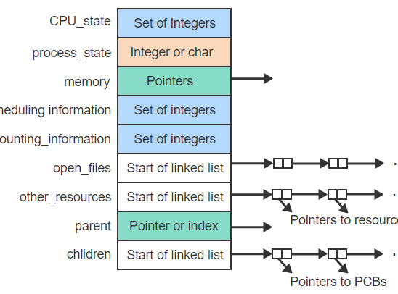
Data Structures – PCB
The memory field contains one or more pointers (memory addresses) and the parent field designates the parent process using a pointer or array index.

Slide 37
Organizing PCBs
The OS must allocate and deallocate PCBs efficiently as processes are created and destroyed. Two ways exist to organize all PCBs:
An array of structures. The PCBs are marked as free or allocated, which eliminates the need for any dynamic memory management. The main drawback is a lot of wasted memory space to maintain a sufficient number of PCB slots.
An array of pointers to dynamically allocated PCBs. The pointer array wastes little space and can be made much larger than the array of structures. The drawback is the overhead of dynamic memory management to allocate each new PCB and to free the memory when the process terminates.

Slide 38
Why We Avoid Linked Lists
An array of pointers to dynamically allocated PCBs. The pointer array wastes little space and can be made much larger than the array of structures. The drawback is the overhead of dynamic memory management to allocate each new PCB and to free the memory when the process terminates.
Instead of a separate linked list anchored in the parent's PCB, the links are distributed over the child PCBs such that each points to the immediate younger sibling and immediate older sibling. The original 2 fields, parent and children, in the PCB of a process p are replaced by 4 new fields:
parent: points to p's single parent as before
first_child: points to p's first child
younger_sibling: points to the sibling of p created immediately following p
older_sibling: points to the sibling of p created immediately prior to p

Slide 39
Managing PCBs
The OS maintains all PCBs organized on various lists.
A waiting list is associated with every resource and contains all processes blocked on that resource because the resource is not available.
Another important list is the ready list (RL): A list containing all processes that are in the ready state and thus are able to run on the CPU.
The RL maintains all processes sorted by their importance, which is expressed by an integer value called the priority.
The RL can be a simple linked list where the priority of a process is the current position in the list. The RL can also maintain processes in different lists sorted by priorities.

Slide 40
Operations on Processes
A process creation hierarchy is a graphical representation of the dynamically changing parent-child relationships among all processes. (Take a look at participation activity 2.4.1 on ZyBooks)
The create process function allocates a new PCB, fills the PCB entries with initial values, and links the PCB to other data structures in the system.
The destroy process function destroys a process by freeing the PCB data structure and removing any references to the PCB from the system.

Slide 41
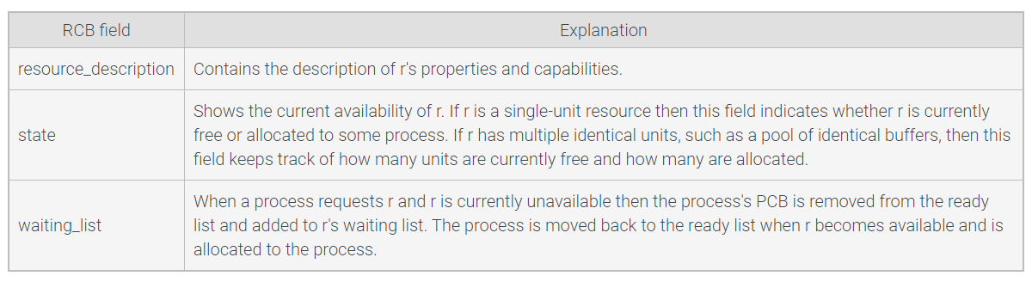
Resources
A resource control block (RCB) is a data structure that represents a resource.
Generic RCB:

Slide 42
Resources – Important Concepts
Allocated: A resource is allocated to a process if the process has access to and is able to utilize the resource.
Free: A resource is free if the resource may be allocated to a requesting process.
Request Resource Function: Allocates a resource r to a process p or blocks p if r is currently allocated to another process.
Release Resource Function: Allocates the resource r to the next process on the r's waiting list. If the waiting list is empty, r is marked as free.
Scheduler Function: determines which process should run next and starts the process.
We will discuss schedulers next week!

Slide 43
Threads
Thread: An instance of executing a portion of a program within a process.
Typical uses of threads:
A browser can draw an image on the screen while at the same time waiting for data from the Internet. One thread can be busy drawing the image while another can keep blocking while retrieving the data.
A word processor can run a spell checker at the same time as the user is typing. Waiting for each typed character and displaying the data on the screen can be done concurrently by two separate threads.
An Internet server, such as an email or web page server, is receiving many requests from different users at the same time. When each request is implemented as a new thread, many requests can proceed concurrently without holding up the progress of others.

Slide 44
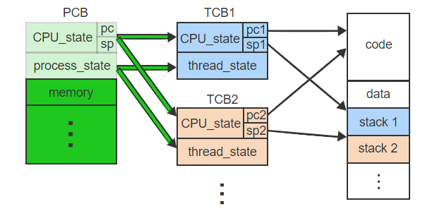
Thread Control Block (TCB)
A thread control block (TCB) is a data structure that holds a separate copy of the dynamically changing information necessary for a thread to execute independently.

Slide 45
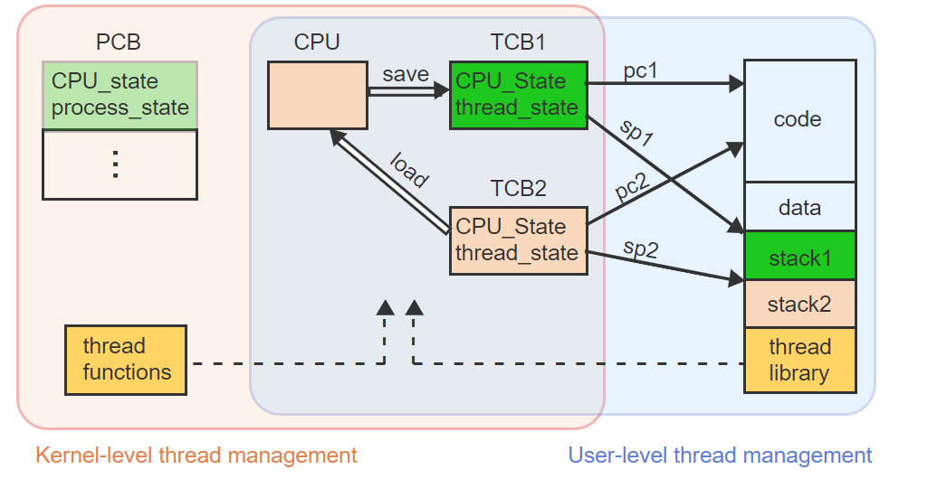
User Level & Kernel Level Threads
With user-level threads, all thread management occurs within the user process. The kernel is not aware of the multiple threads.
With kernel-level threads, the thread management is handled by the kernel using internal thread functions. The application uses kernel calls to request any action.

Slide 46
Introduction to C Programming
Created by Dennis Ritchie at AT&T Labs in 1972
Originally created to design and support the Unix OS
There are only 27 keywords in the original version of C.
For, goto, else, etc…
Which made it easier to build a compiler for C.
Many people have written compilers for C.
C compilers are available for virtually every platform.
In 1983 the American National Standards Institute (ANSI) formed a committee to establish a standard definition
Called ANSI Standard C.
As opposed to K&R C (referring to the general “standards” that appeared in the first edition of Brian Kernighan and Ritchie’s influential book: The C Programming Language)

Slide 47
Why use C?
C is intended as a language for programmers
BASIC was for nonprogrammers to program and solve simple problems.
C was created, influenced, and field-tested by working programmers.
C is powerful and efficient
You can nearly achieve the efficiency of assembly code
System calls and pointers allow you do most of the things that you can do with an assembly language.
C is a structured language
Code can be written and read much easier.
C is standardized
Your ANSI C program should work with any ANSI C compiler (across multiple platforms)

Slide 48
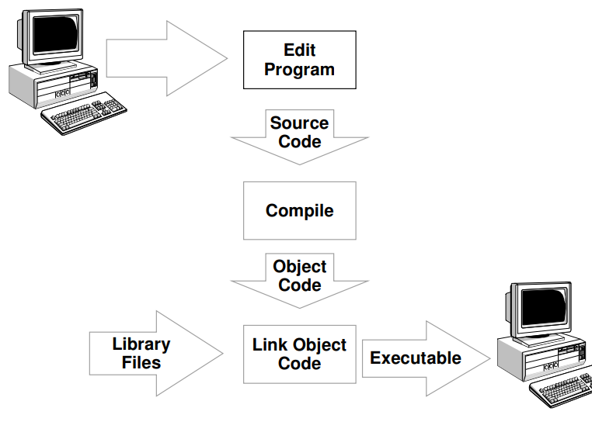
The C Development Cycle

Slide 49
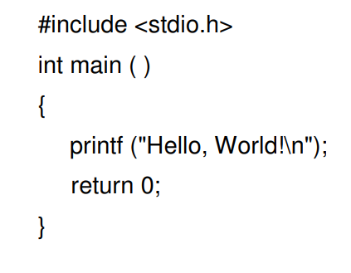
C Hello World
No classes in C!

Slide 50
Header Files
The C programming language provides many standard library functions for file input and output. These functions make up the bulk of the C standard library header <stdio.h>.
C – stdio.h library functions:
printf() This function is used to print the character, string, float, integer, octal and hexadecimal values onto the output screen
scanf() This function is used to read a character, string, numeric data from keyboard.
getc() It reads character from file
gets() It reads line from keyboard
getchar() It reads character from keyboard
puts() It writes line to o/p screen
Many many more!

Slide 51
Compilation
Compilation translates your source code (in the file hello.c) into object code (machine dependent instructions for the particular machine you are on).
Linking the object code will generate an executable file.
There are many compilers for C under Unix
We will transition to Loki in a few minutes and compile and run our first real program.

Slide 52
Example 1
#include <stdio.h>
int main ()
{
int radius, area;
printf ("Enter radius (i.e. 10) : ");
scanf ( "%d", &radius);
area = 3.14159 * radius * radius;
printf ("\nArea = %d\n\n", area);
return 0;
}

Slide 53
Example 2
#include <stdio.h>
int main ()
{
int i, j;
for (i = 0; i < 10; i++)
{
printf ("\n");
for (j = 0; j < i+1; j++ )
printf ( "A");
}
printf("\n");
return 0;
}

Slide 54
Example 3
Lets move to a text editor with proper highlighting!
We will then login to Loki via SSH and compile/run our first program.

